Slide 1
MI1562 – API y Microservicios
Spring Boot
Módulos-Anotaciones

Slide 2
Módulos Spring 5
CORE CONTAINER
spring-core, spring-beans, spring-context, spring-context-support, and spring-expression
AOP
spring-aop AOP Alliance-compliant aspect-oriented programming implementation. spring-aspects integration with AspectJ.
Messaging spring-messaging - Spring Integration project: Message, MessageChannel, MessageHandler
DATA ACCESS/INTEGRATION LAYER
JDBC, ORM, OXM, JMS, Transaction modules.
spring-jdbc module provides a JDBC-abstraction layer
spring-tx module supports programmatic and declarative transaction management
spring-orm module provides integration layers for popular object-relational mapping APIs, including JPA and Hibernate
spring-oxm module provides an abstraction layer that supports Object/XML mapping implementations

Slide 3
Módulos Spring 5
WEB LAYER
spring-web, spring-webmvc, spring-websocket modules.
spring-web basic web-oriented integration features
spring-webmvc model-view-controller (MVC) and REST Web Services implementation for web applications
TESTING
spring-test supports unit testing and integration testing of Spring components with JUnit or TestNG. Loading of Spring ApplicationContexts and caching of those contexts. It also provides mock objects

Slide 4
Artefactos
GroupId | ArtifactId | Description
org.springframework | spring-aop | Proxy-based AOP support
org.springframework | spring-aspects | AspectJ based aspects
org.springframework | spring-beans | Beans support, including Groovy
org.springframework | spring-context | Application context runtime, including scheduling and remoting abstractions
org.springframework | spring-context-support | Support classes for integrating common third-party libraries into a Spring application context
org.springframework | spring-core | Core utilities, used by many other Spring modules
org.springframework | spring-expression | Spring Expression Language (SpEL)
org.springframework | spring-instrument | Instrumentation agent for JVM bootstrapping
org.springframework | spring-instrument-tomcat | Instrumentation agent for Tomcat
org.springframework | spring-jdbc | JDBC support package, including DataSource setup and JDBC access support
org.springframework | spring-jms | JMS support package, including helper classes to send/receive JMS messages

Slide 5
Artefactos
GroupId | ArtifactId | Description
org.springframework | spring-messaging | Support for messaging architectures and protocols
org.springframework | spring-orm | Object/Relational Mapping, including JPA and Hibernate support
org.springframework | spring-oxm | Object/XML Mapping
org.springframework | spring-test | Support for unit testing and integration testing Spring components
org.springframework | spring-tx | Transaction infrastructure, including DAO support and JCA integration
org.springframework | spring-web | Foundational web support, including web client and web-based remoting
org.springframework | spring-webmvc | HTTP-based Model-View-Controller and REST endpoints for Servlet stacks
org.springframework | spring-websocket | WebSocket and SockJS infrastructure, including STOMP messaging support

Slide 6
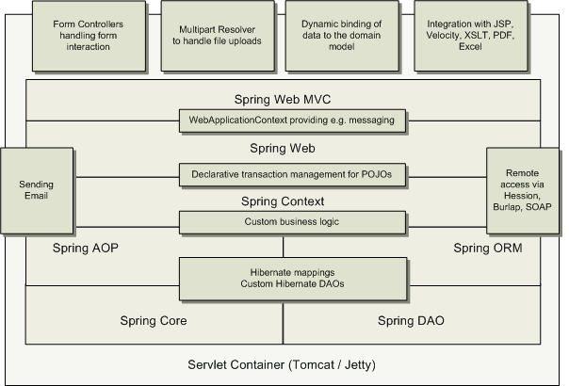
Escenario Spring

Slide 7
Spring Boot
The problem with Spring and Spring MVC is the amount of configuration that is needed
Spring Boot solves this problem through a combination of Auto Configuration and Starter Projects.
Spring Boot also provides a few features to make building production-ready applications faster.
Embedded Server
Spring Boot Starter Projects
a set of convenient dependency descriptors that you can include in your application

Slide 8
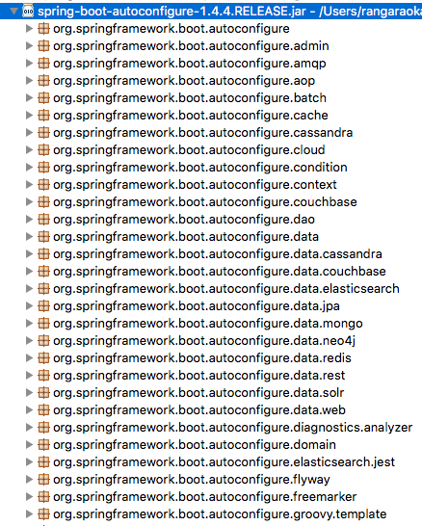
Spring Boot Starter Web - Example
Spring — core, beans, context, AOP
Web MVC — (Spring MVC)
Jackson — for JSON Binding
Validation — Hibernate Validator, Validation API
Embedded Servlet Container — Tomcat
Logging — logback, slf4j

Slide 9
Módulos SpringBoot Starter modules
Spring Boot Starter Parent
spring-boot-starter-web-services: Build applications exposing SOAP web services
spring-boot-starter-web: Build Web applications and RESTful applications
spring-boot-starter-test: Write great unit and integration tests
spring-boot-starter-jdbc: Traditional JDBC applications
spring-boot-starter-hateoas: Make your services more RESTful by adding HATEOAS features
spring-boot-starter-security: Authentication and authorization using Spring Security
spring-boot-starter-data-jpa: Spring Data JPA with Hibernate
spring-boot-starter-cache: Enabling Spring Framework’s caching support
spring-boot-starter-data-rest: Expose simple REST services using Spring Data REST

Slide 10
Módulos Spring Data
Provide a familiar and consistent, Spring-based programming model for data access
Spring Data JPA — relational databases
Spring Data MongoDB
Spring Data REST — Expose awesome REST APIs around Spring Data Repositories

Slide 11
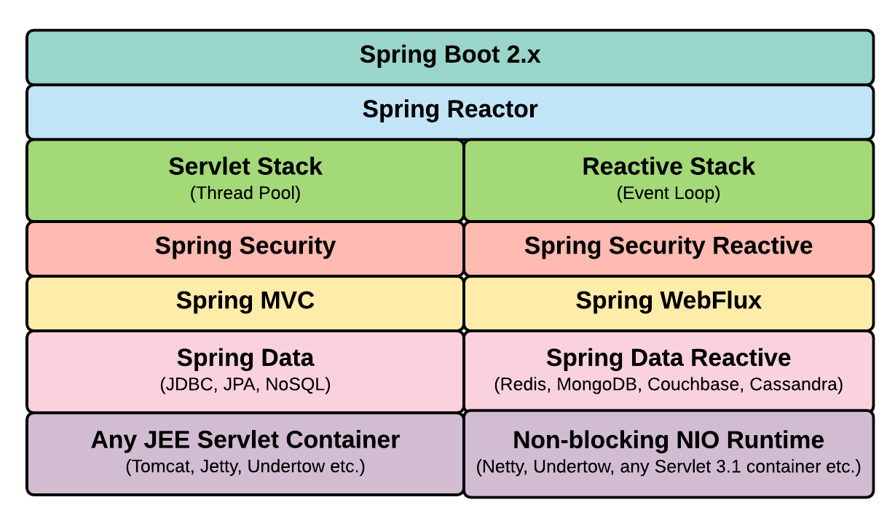
Módulos SpringBoot 2 Reactive

Slide 12
Anotaciones Spring
https://springframework.guru/spring-framework-annotations/
Anotaciones JPA
https://dzone.com/articles/all-jpa-annotations-mapping-annotations

